Slide 1
Data Wrangling and EDA

Slide 2
Agenda
Descriptive Statistics
Missing Value Analysis
Outlier Analysis
Testing Normality
Variable Transformation
Correlation/ Association Analysis
Univariate Analysis
Multivariate Analysis
Feature Engineering

Slide 3
Descriptive Statistics
Member Age - Descriptive Statistics
Mean | 42
Median | 41
Mode | 38
Standard Deviation | 12.0
Sample Variance | 144.0
Kurtosis | 0.5
Skewness | 0.7
Range | 86
Minimum | 16
Maximum | 102
Sum | 111435
Count | 3022

Slide 4
Missing Value - Types
MCAR (Missing Completely at Random)
Probability of being missing is the same for all cases; e.g. random selection of people for a survey
MAR (Missing at Random)
Probability of being missing is the same only within groups defined by the observed data; e.g. a sample from a population, where the probability to be included depends on gender
NMAR (Not Missing at Random)
Probability of being missing varies for reasons that are unknown to us; e.g. MNAR in public opinion research occurs if those with weaker opinions respond less often
Reference - https://stefvanbuuren.name/fimd/sec-MCAR.html

Slide 5
Missing Value - Strategies
Delete the features carrying missing values
Delete the records with missing values
Impute missing values
Create another group for missing values

Slide 6
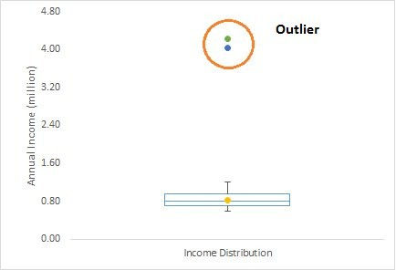
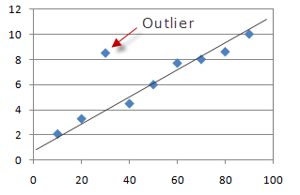
Outlier Analysis
“Observation which deviates so much from other observations as to arouse suspicion it was generated by a different mechanism” — Hawkins(1980)

Slide 7
Outlier Analysis
Outlier Detection -
z Score > 3 | z Score < -3 [Histogram]
Xi < X1-1.5 IQR | Xi> X3+1.5 IQR [Boxplot]
Scatter Plots (for multivariate outliers)
Outlier Treatment -
Delete the outliers
Cap the outliers
Transform the variable containing outliers
Treat separately (build separate model for outliers)

Slide 8
Normality Analysis
Normality Test -
Skewness(>-1 and <1) and Kurtosis (>-2 and <2)
Probability plots
Hypothesis Tests - Shapiro Wilk, Anderson Darling etc.
Abnormality Treatment -
Variable transformation
Remove Outliers

Slide 9
Variable Transformation
Right Skewed -
Square root transformation
Log transformation
Box Cox transformation
Left Skewed-
Square transformation
Exponential transformation
Box Cox transformation

Slide 10
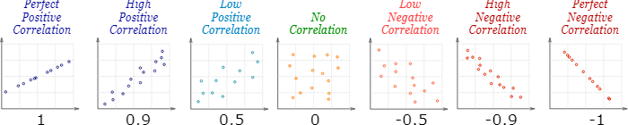
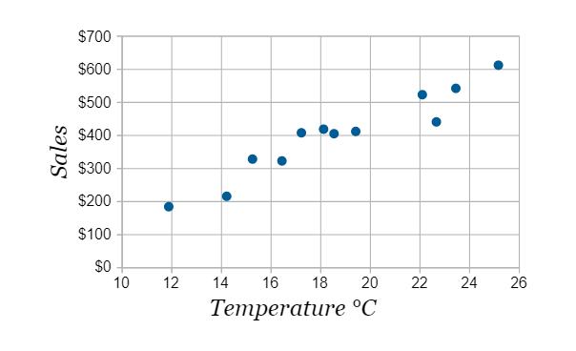
Correlation Analysis
Ice Cream Sales vs Temperature
Temperature °C | Ice Cream Sales
14.2° | $215
16.4° | $325
11.9° | $185
15.2° | $332
18.5° | $406
22.1° | $522
19.4° | $412
25.1° | $614
23.4° | $544
18.1° | $421
22.6° | $445
17.2° | $408
Reference - https://www.mathsisfun.com/

Slide 11
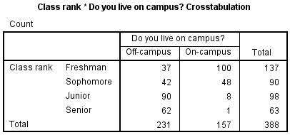
Association Analysis
χ2 test
Cramer's V
Reference - https://libguides.library.kent.edu/SPSS/Crosstabs

Slide 12
Univariate and Multivariate Analysis
Histogram: numeric variable
Box plots: numeric variable
Bar plots: categorical variable
Pie chart: categorical variable
Scatterplot: numeric vs numeric
Cross-tab: categorical vs categorical
Line chart: Time series data

Slide 13
Feature Engineering
The features you use influence more than everything else the result. No algorithm alone, to my knowledge, can supplement the information gain given by correct feature engineering
— Luca Massaron
Techniques -
Binning
Feature split
Merging features
Date extraction

